Slide 1

NEXT JS
React is relatively unopinionated about how you build and structure your applications.
There are multiple ways to build applications with React.
Next.js provides a framework to structure your application.
And optimizations that help make both the development process and final application faster.

Slide 2
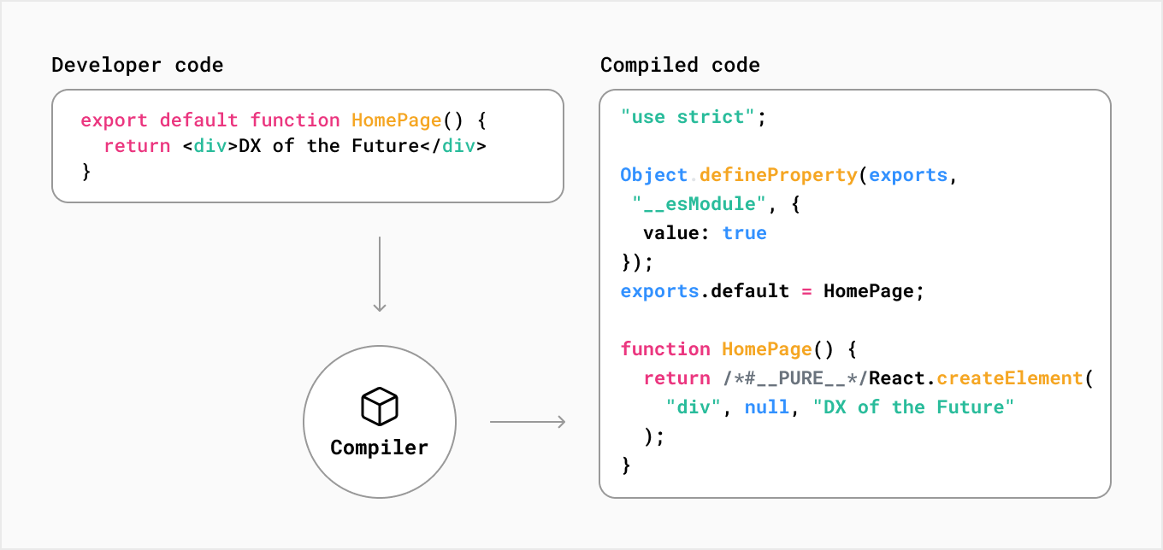
Developer Code & Compiled Code

Slide 3
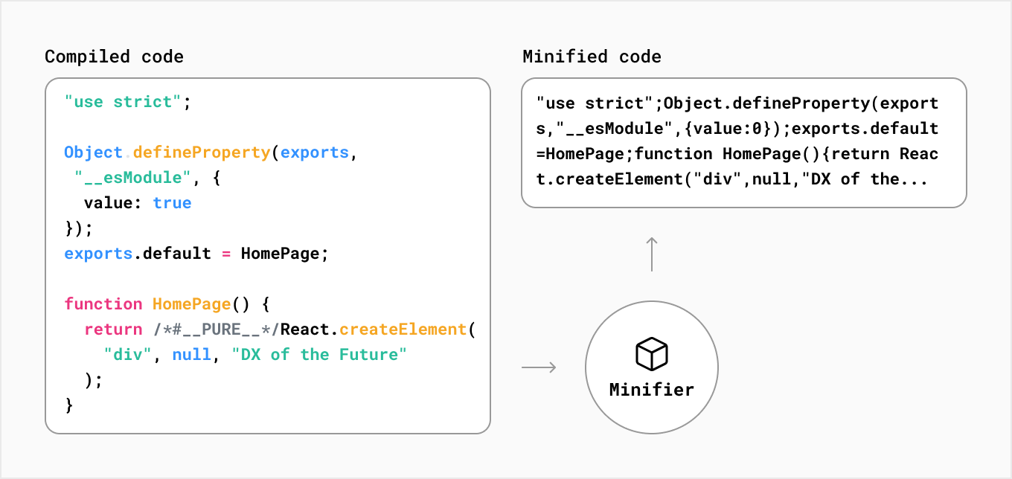
Compiled Code & Minified Code

Slide 4
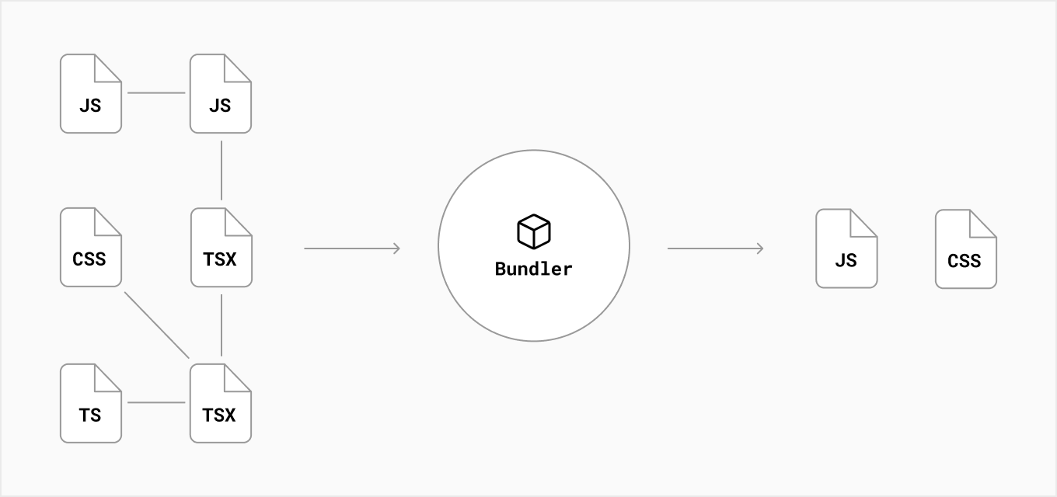
Bundler Concepts

Slide 5
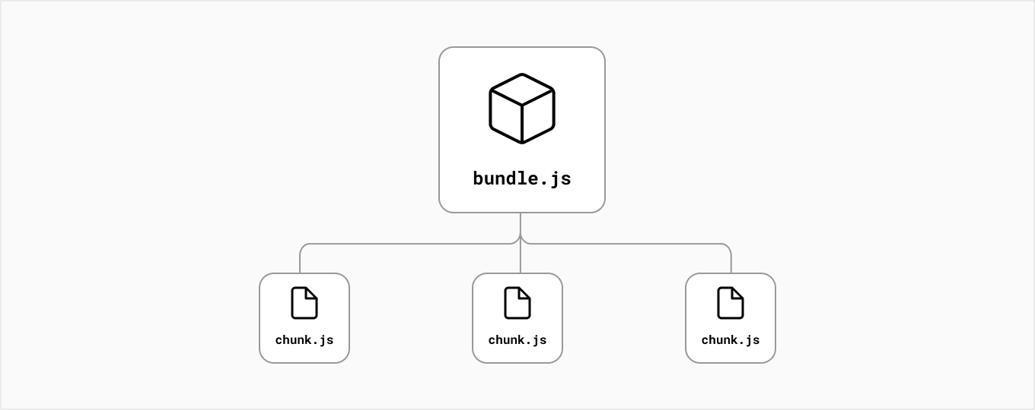
Bundle Splitting

Slide 6
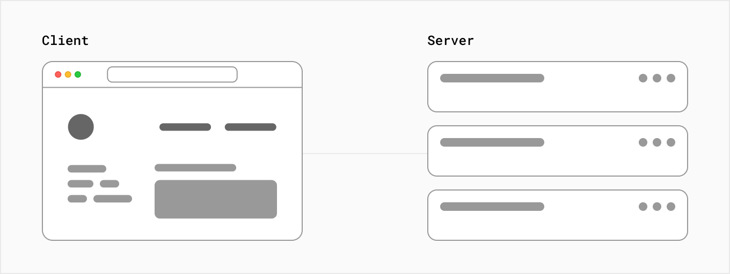
Client-Server Concepts

Slide 7
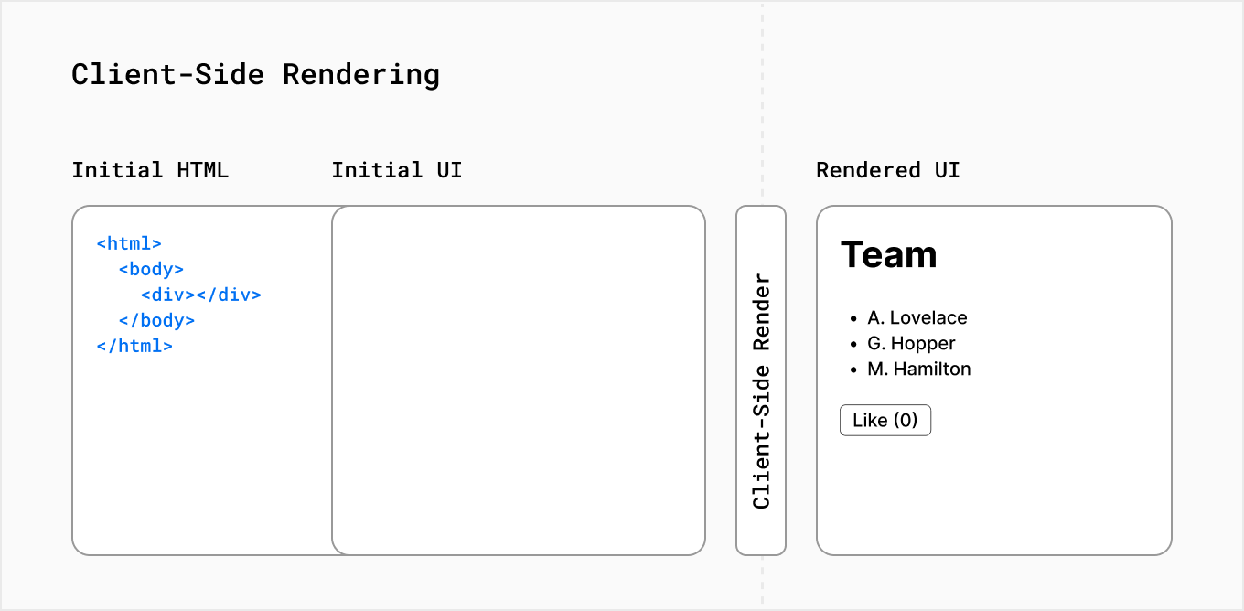
Client Side Rendering

Slide 8
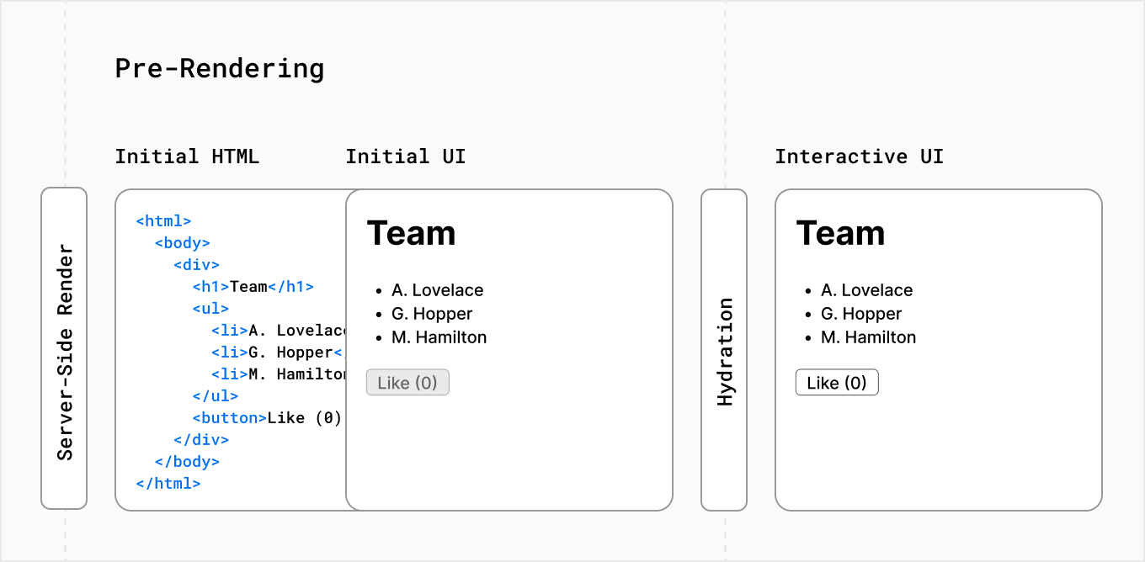
Server Side Rendering

Slide 9



Create & Run New Project

Slide 10
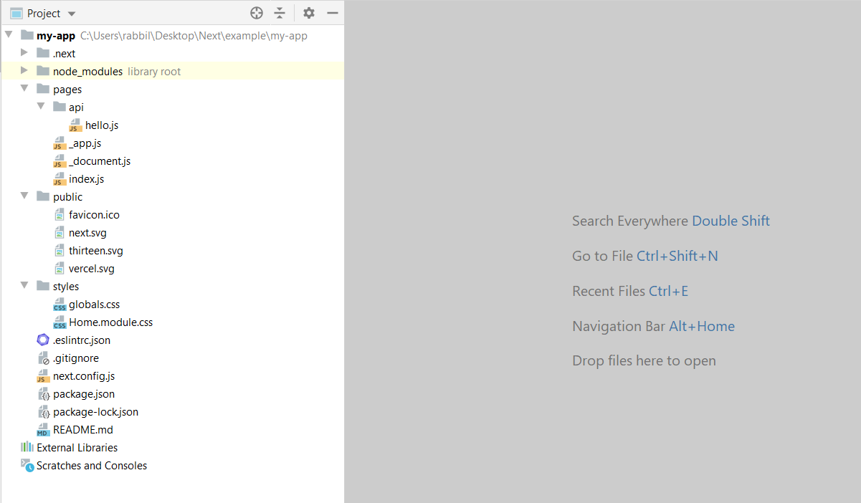
File Folder Structure

Slide 11
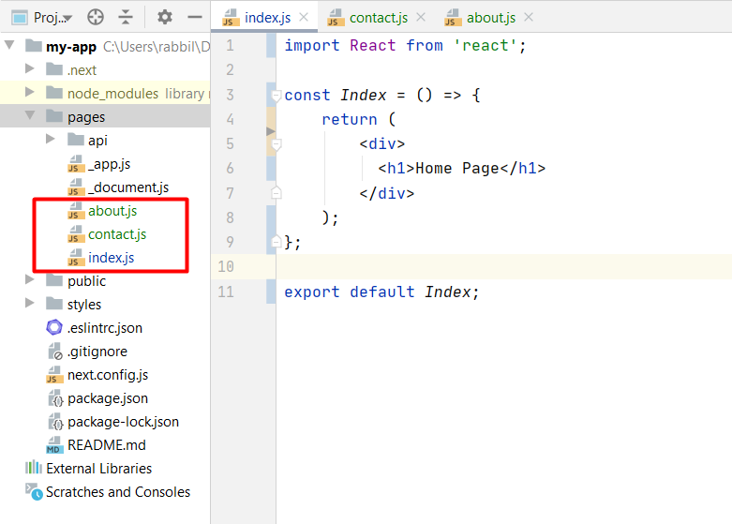
Page Concepts

Slide 12
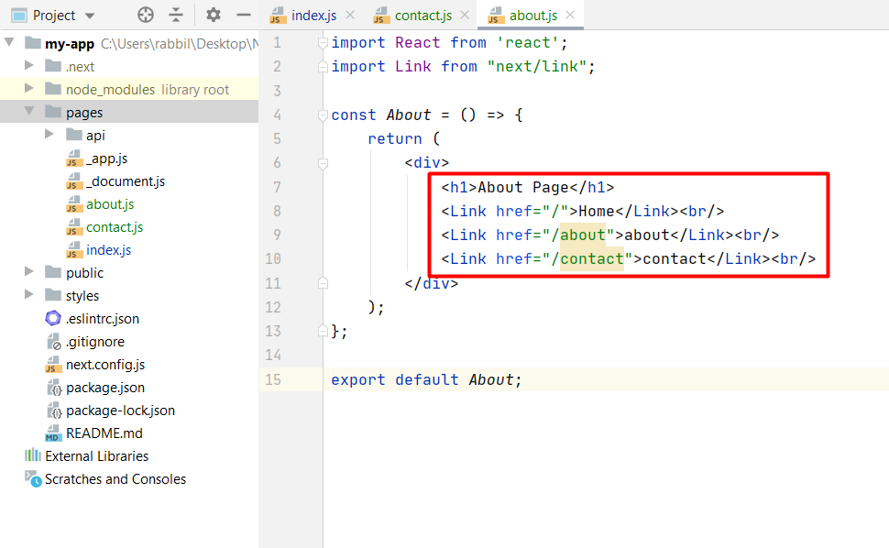
Link Component
When linking between pages on websites, you use the <a> HTML tag.
In Next.js, you can use the Link Component next/link to link between pages in your application.
Allows you to do client-side navigation and accepts props that give you better control over.

Slide 13
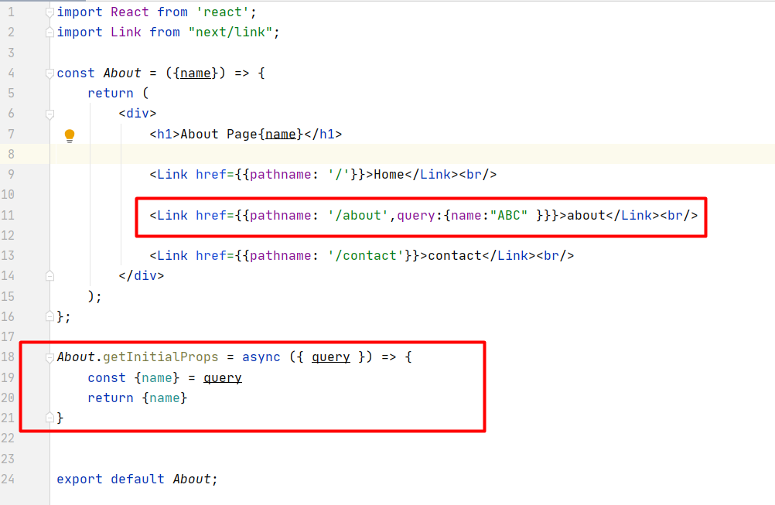
Link With Query

Slide 14
getInitialProps
getInitialProps enables server-side rendering in a page
Allows you to do initial data population
Sending the page with the data already populated from the server.
This is especially useful for SEO

Slide 15
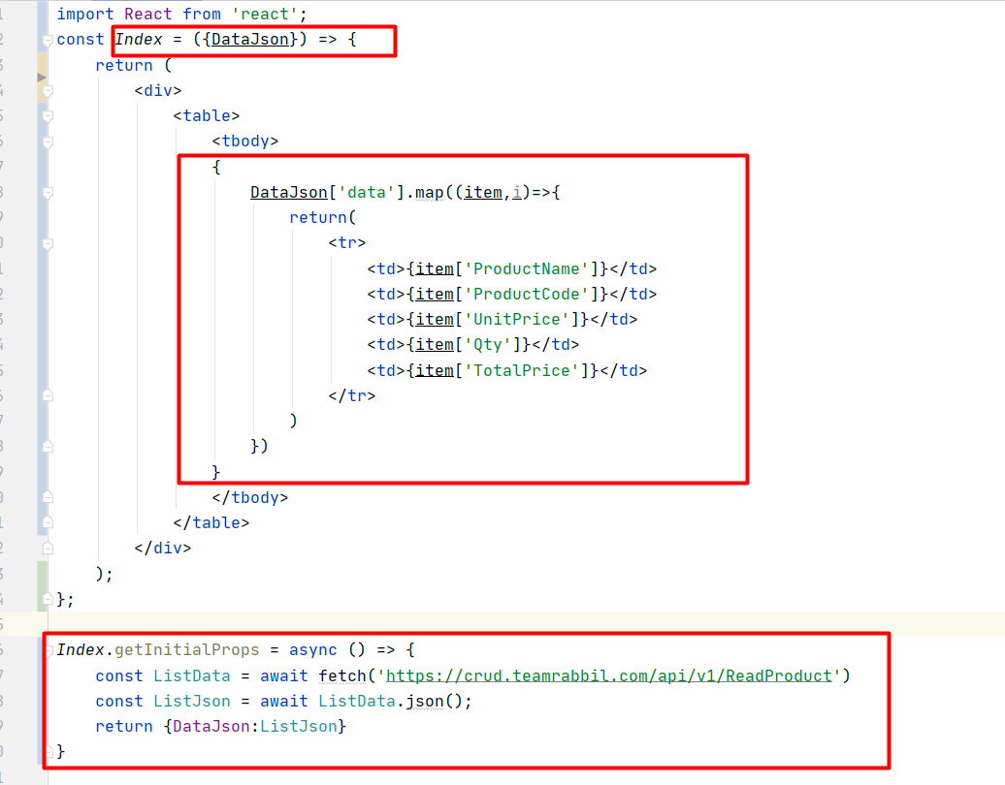
getInitialProps

Slide 16
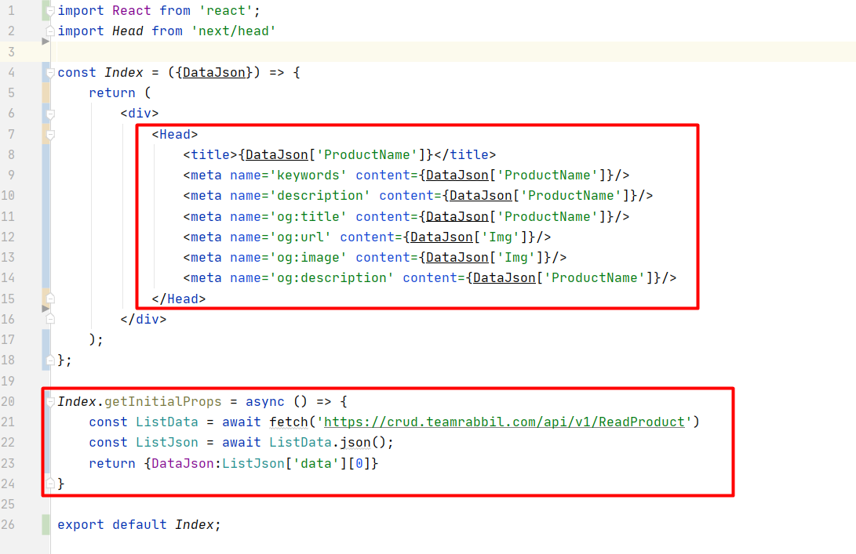
getInitialProps SEO

Slide 17
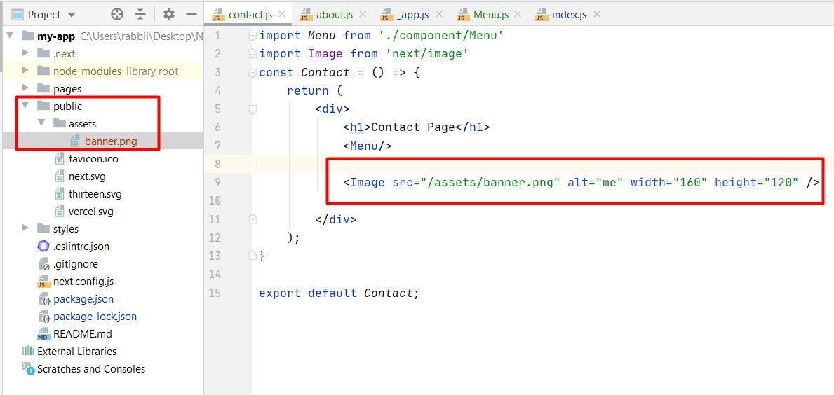
Static files

Slide 18
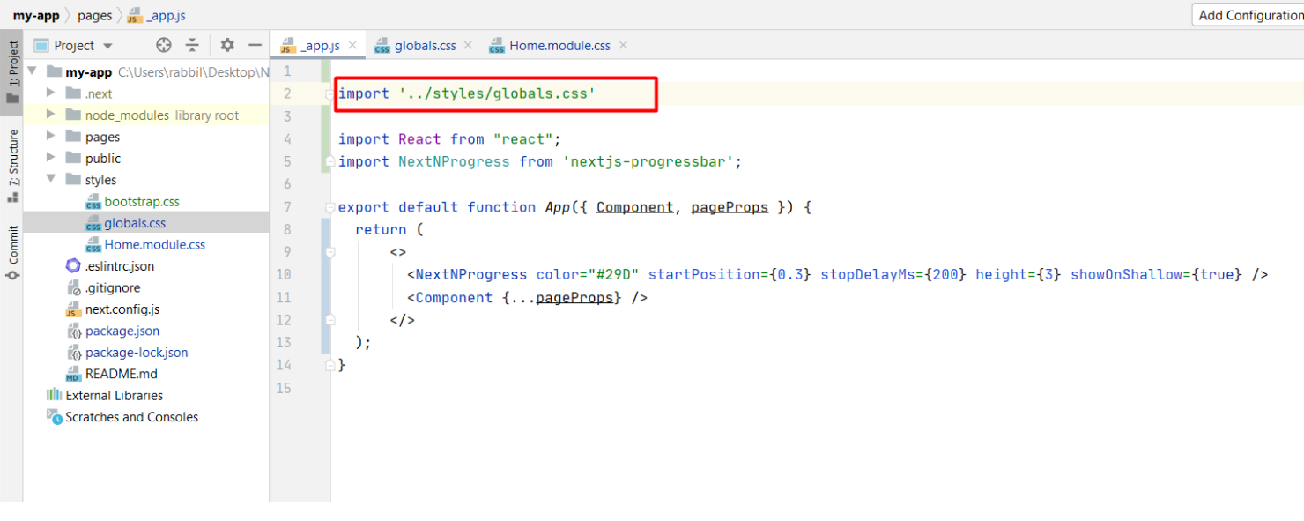
Global Style

Slide 19
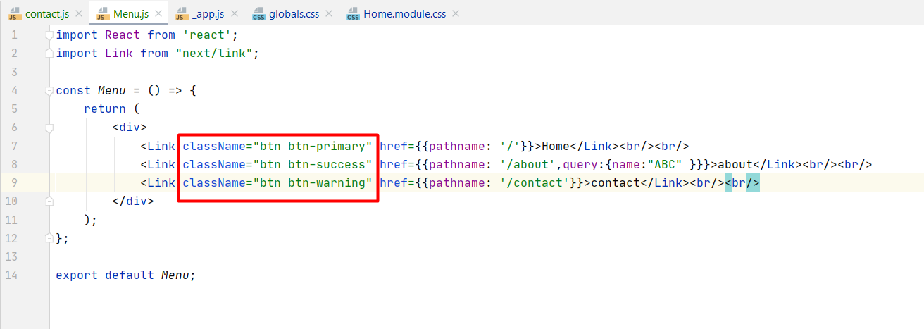
Global Style

Slide 20
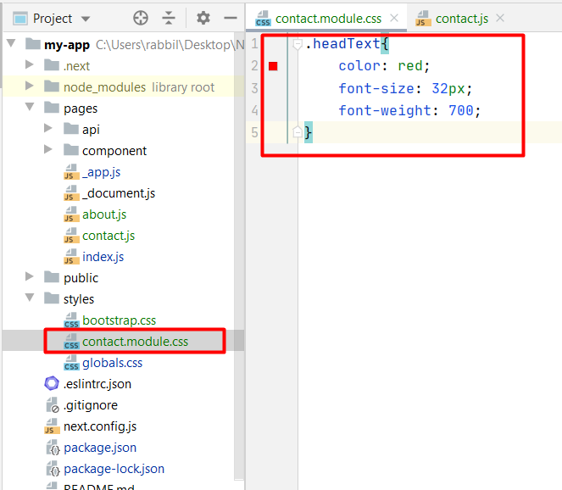
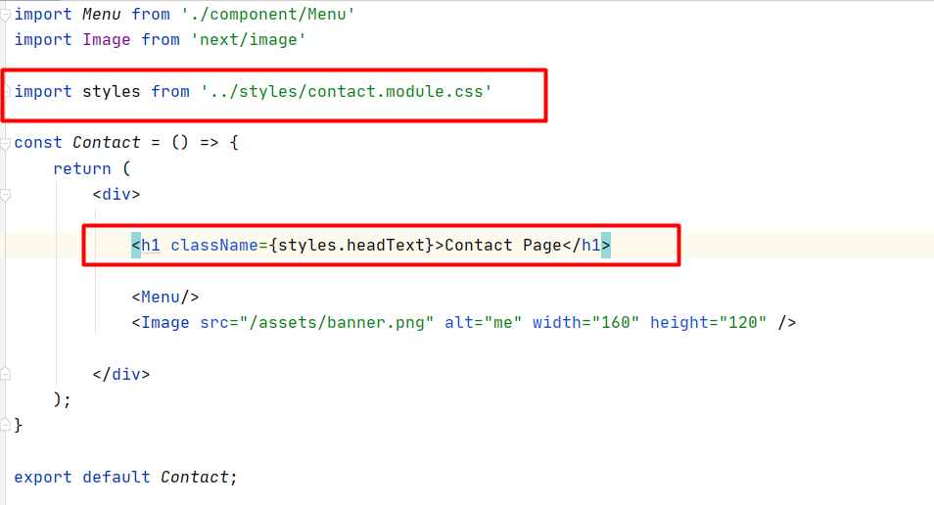
Component-Level CSS

Slide 21
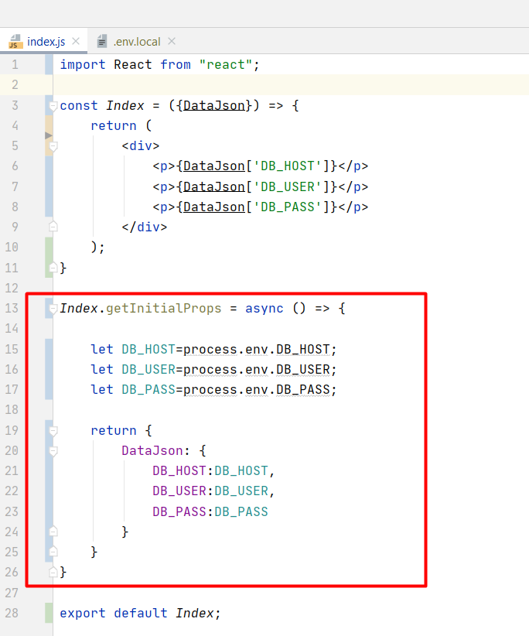
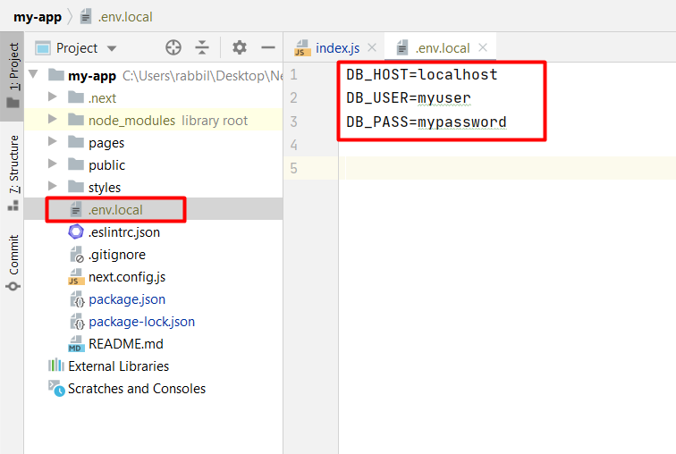
Environment Variables

Slide 22
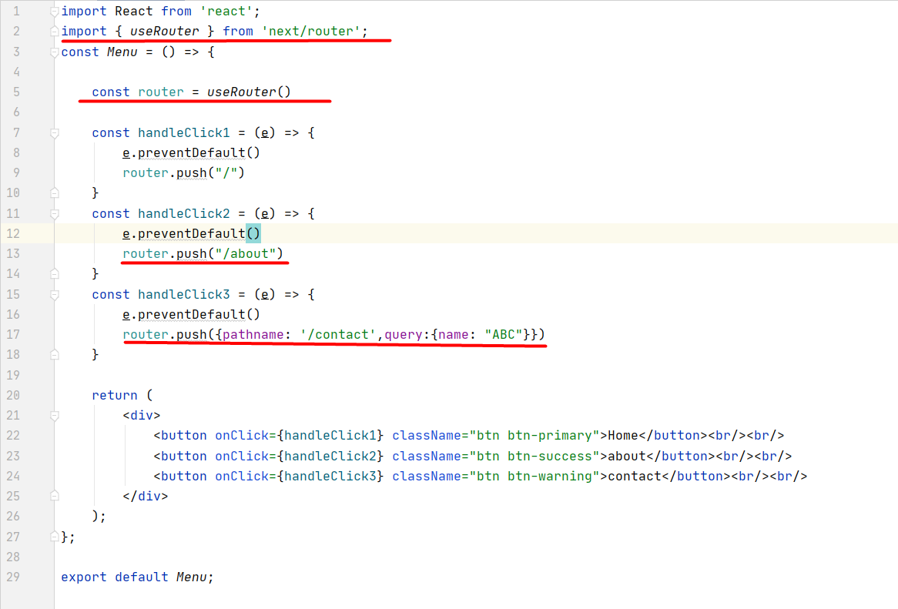
Next router

Slide 23
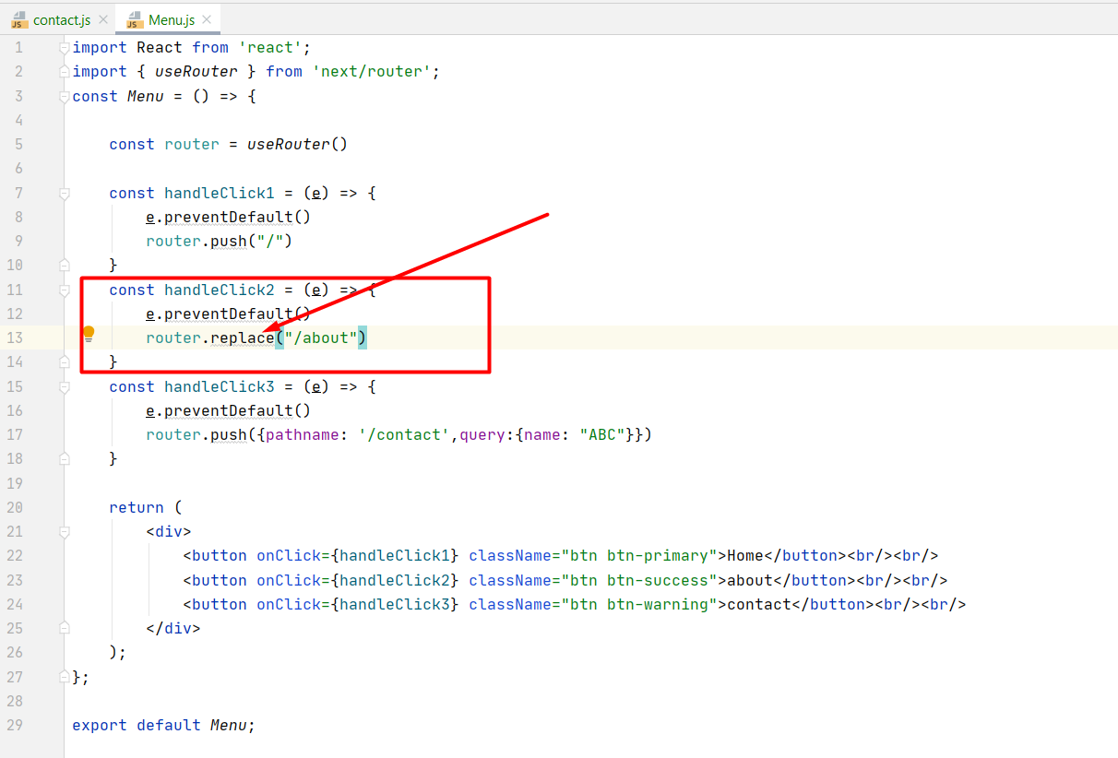
Next router

Slide 24
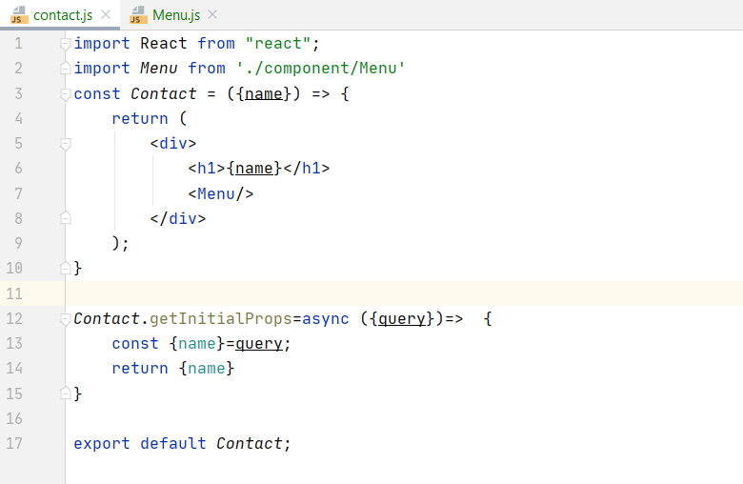
Next router

Slide 25
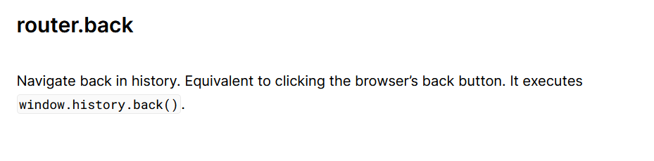
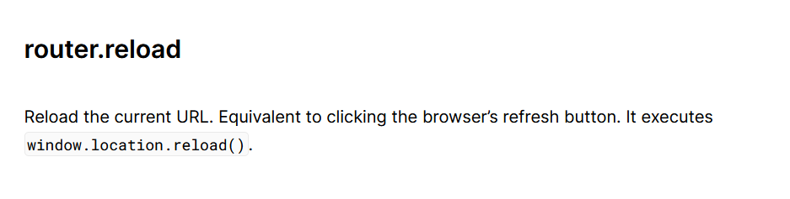
Next router

Slide 26

Next Router/Navigation Progress

Slide 27
API Router
How API Routes Works.
How to manage get, post, methods
Managing request - response URL Query , Body, Header

